Slide 1
Why Have Biologists Still Not Developed an HIV Vaccine? Hidden Markov Models
Phillip Compeau and Pavel Pevzner
Bioinformatics Algorithms: An Active Learning Approach
©2018 by Compeau and Pevzner. All rights reserved.

Slide 2
Why Have Biologists Still Not Developed an HIV Vaccine?
Classifying HIV Phenotypes
Gambling with Yakuza
From a Casino to a Hidden Markov Model
Decoding Problem
The Viterbi Algorithm
Profile HMMs for Sequence Alignment
Classifying proteins with profile HMMs
Viterbi Learning
Soft Decoding Problem
Baum-Welch Learning

Slide 3
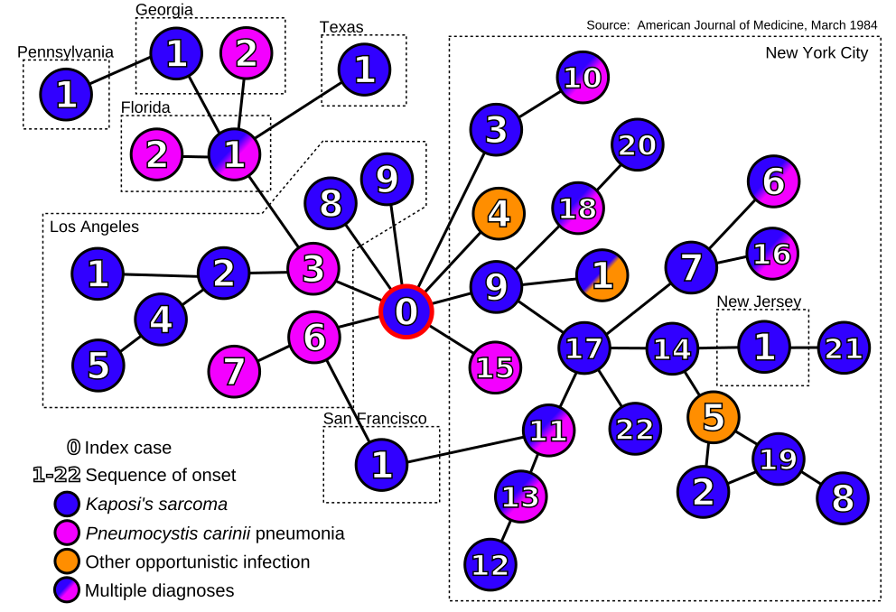
Waiting for an HIV Vaccine…
1984: Scientists traced 40 early HIV-infected patients to a flight attendant named AIDS “Patient Zero”. He died in the same year.

Slide 4
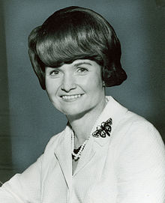

Waiting for an HIV Vaccine…
1984: Scientists traced 40 early HIV-infected patients to a flight attendant named AIDS “Patient Zero”. He died in the same year.
1984: Margaret Heckler (US Health Secretary)
Yet another terrible disease is about to yield to patience, persistence and outright genius
1997: Bill Clinton
It is no longer a question of whether we can develop an AIDS vaccine, it is simply a question of when.
2007: Merck discontinued trials of the HIV vaccine after learning that it increased the risk of infection.

Slide 5

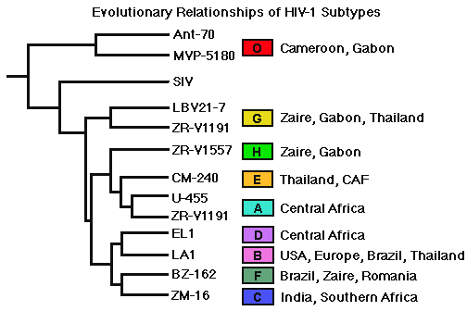
How Does HIV Evade the Immune System?
Vaccines are often made from virus surface proteins to train the immune system to recognize viral envelope proteins and destroy them.
This approach failed in the case of HIV because its viral envelope proteins are extremely variable – there are many HIV subtypes.
Evolution of HIV subtypes

Slide 6
A Myriad of HIV Subtypes
The HIV population in a single infected individual rapidly evolves to evade the immune system.
HIV strains from different patients represent diverged phenotypes requiring different drug cocktails.
envelope glycoprotein gp120
VKKLGEQFR-NKTIIFNQPSGGDLEIVMHSFNCGGEFFYCNTTQLFN----------NSTES------DTITL
VKKLGEQFR-NKTIIFNQPSGGDLEIVMHSFNCGGEFFYCNTTQLFN----------NSTDNG-----DTITL
VKKLGEQFR-NKTIIFNQPSGGDLEIVMHSFNCGGEFFYCNTTQLFD----------NSTESNN----DTITL
VDKLREQFGKNKTIIFNQPSGGDLEIVMHTFNCGGEFFYCNTTQLFNSTWNS---TGNGTESYNGQENGTITL
VDKLREQFGKNKTIIFNQPSGGDLEIVMHTFNCGGEFFYCNTTQLFNSTWNG---TNTT--GLDG--NDTITL
VDKLREQFGKNKTIIFNQSSGGDLEIVTHTFNCGGEFFYCNTTQLFNSNWTG---NSTE--GLHG--DDTITL
VKKLGEQFG-NKTIIFNQSSGGGLEIVMHSFNCGGEFFYCNTTQLFNN--TR-----NSTESNNGQGNDTTTL
VKKLREQFGKNKTIIFKQSSGGDLEIVTHTFNCAGEFFYCNTTQLFNSNWTE-----NSITGLDG--NDTITL
VGKLREQFGK-KTIIFNQPSGGDLEIVMHSFNCQGEFFYCNTTRLFNSTWDNSTWNSTGKDKENGN-NDTITL

Slide 7
Syncytium-Inducing Phenotype
HIV can “trick” human cells into fusing with neighboring cells, creating a giant cell (syncytium) that allows the virus to kill many cells at once.
Can we identify syncytium-inducing (SI) HIVs
based on their genomes?

Slide 8

Identifying Syncytium-Inducing HIVs: 11-25 Rule
11 25
CMRPGNNTRKSIHMGPGKAFYATGDIIGDIRQAHC
CMRPGNNTRKSIHMGPGRAFYATGDIIGDTRQAHC
CMRPGNNTRKSIHIGPGRAFYATGDIIGDIRQAHC
CMRPGNNTRKSIHIGPGRAFYTTGDIIGDIRQAHC
CTRPNNNTRKGISIGPGRAFIAARKIIGDIRQAHC
CTRPNNYTRKGISIGPGRAFIAARKIIGDIRQAHC
CTRPNNNTRKGIRMGPGRAFIAARKIIGDIRQAHC
CVRPNNYTRKRIGIGPGRTVFATKQIIGNIRQAHC
CTRPSNNTRKSIPVGPGKALYATGAIIGNIRQAHC
CTRPNNHTRKSINIGPGRAFYATGEIIGDIRQAHC
CTRPNNNTRKSINIGPGRAFYATGEIIGDIRQAHC
CTRPNNNTRKSIHIGPGRAFYTTGEIIGDIRQAHC
CTRPNNNTRKSINIGPGRAFYTTGEIIGNIRQAHC
CIRPNNNTRGSIHIGPGRAFYATGDIIGEIRKAHC
CIRPNN-TRRSIHIGPGRAFYATGDIIGEIRKAHC
CTRPGSTTRRHIHIGPGRAFYATGNILGSIRKAHC
CTRPGSTTRRHIHIGPGRAFYATGNI-GSIRKAHC
CTGPGSTTRRHIHIGPGRAFYATGNIHG-IRKGHC
CMRPGNNTRRRIHIGPGRAFYATGNI-GNIRKAHC
CMRPGTTTRRRIHIGPGRAFYATGNI-GNIRKAHC
CMRPGNNTRKSIHMGPGKAFYATGDIIGDIRQAHC
CMRPGNNTRKSIHMGPGRAFYATGDIIGDTRQAHC
CMRPGNNTRKSIHIGPGRAFYATGDIIGDIRQAHC
CMRPGNNTRKSIHIGPGRAFYTTGDIIGDIRQAHC
CTRPNNNTRKGISIGPGRAFIAARKIIGDIRQAHC
CTRPNNYTRKGISIGPGRAFIAARKIIGDIRQAHC
CTRPNNNTRKGIRMGPGRAFIAARKIIGDIRQAHC
CVRPNNYTRKRIGIGPGRTVFATKQIIGNIRQAHC
CTRPSNNTRKSIPVGPGKALYATGAIIGNIRQAHC
CTRPNNHTRKSINIGPGRAFYATGEIIGDIRQAHC
CTRPNNNTRKSINIGPGRAFYATGEIIGDIRQAHC
CTRPNNNTRKSIHIGPGRAFYTTGEIIGDIRQAHC
CTRPNNNTRKSINIGPGRAFYTTGEIIGNIRQAHC
CIRPNNNTRGSIHIGPGRAFYATGDIIGEIRKAHC
CIRPNNTRRSIHIGPGRAFYATGDIIGEIRKAHC
CTRPGSTTRRHIHIGPGRAFYATGNILGSIRKAHC
CTRPGSTTRRHIHIGPGRAFYATGNIGSIRKAHC
CTGPGSTTRRHIHIGPGRAFYATGNIHGIRKGHC
CMRPGNNTRRRIHIGPGRAFYATGNIGNIRKAHC
CMRPGTTTRRRIHIGPGRAFYATGNIGNIRKAHC
11-25 rule:
SI HIVs have R or K at positions
11 or 25
in the V3 region
V3 region of gp120 protein in HIV

Slide 9
A Limitation of Sequence Alignment
To predict an HIV phenotype, we need an accurate alignment: a single misalignment at a position influencing the SI phenotype leads to an error.
STOP and Think: Was it a good idea to use the same scoring matrix across different columns of an alignment?
We need a statistically solid problem formulation for alignment that uses a different scoring approach at different columns.

Slide 10

Why Have Biologists Still Not Developed an HIV Vaccine?
Classifying HIV Phenotypes
Gambling with Yakuza
From a Crooked Casino to a Hidden Markov Model
Decoding Problem
The Viterbi Algorithm
Profile HMMs for Sequence Alignment
Classifying proteins with profile HMMs
Viterbi Learning
Soft Decoding Problem
Baum-Welch Learning

Slide 11

Cho-Han

Slide 12

The Crooked Casino
A crooked dealer may use one of two identically looking coins:
The fair coin (F) gives heads with probability ½:
Pr_{F}(“Head”) = 1/2 Pr_{F}(“Tail”) = 1/2
The biased coin (B) gives heads with probability ¾:
Pr_{B}(“Head”) = 3/4 Pr_{B}(“Tail”) = 1/4
STOP and Think: Did the dealer use the fair or the biased coin if 63 out of 100 flips resulted in heads?
STOP and Think: What coin is more likely if 63 out of 100 flips resulted in heads?
Hint: 63 is closer to 75 than to 50!

Slide 13
Fair or Biased?
Given a sequence of n flips with k “Heads”:
x = x₁ x₂ . . . x_{n}
The probability this sequence was generated by the fair coin:
Pr(x|F) = Pr_{F}(x₁) *…* Pr_{F}(x_{n}) = (1/2)^{n}
The probability that it was generated by the biased coin:
Pr(x|B) = Pr_{B}(x₁) *…* Pr_{B}(x_{n}) = (3/4)^{k} • (1/4)^{n-k}
Pr(x|F) > Pr(x|B) → fair is more likely
Pr(x|F) < Pr(x|B) → biased is more likely
Equilibrium: P(x|F) = P(x|B)
(1/2)^{n} = (3/4)^{k}• (1/4)^{n-k} → 2^{n} = 3^{k} → k - log₂3 • n → k ≈ 0.632•n
Even though 63 is closer to 75 than to 50,
fair coin is more likely to result in 63 heads!

Slide 14
Why a shirtless dealer?

Slide 15
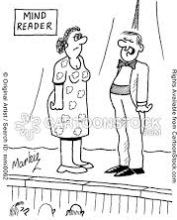
Two Coins Up the Dealer Sleeve
Now the dealer has both fair and biased coins and can change between them at any time (without you noticing) with probability 0.1.
STOP and Think: After watching a sequence of flips, can you tell when the dealer was using fair coin and when he was using biased coin?
“Madam…. How can I be expected to read your mind when you keep changing it?”

Slide 16
Reading the Dealer’s Mind
Casino Problem: Given a sequence of coin flips, determine when the dealer used a fair coin and a biased coin.
Input: A sequence x = x₁ x₂ . . . x_{n} of flips made by coins F (fair) and B (biased).
Output: A sequence π = π₁ π₂ · · · π_{n}, with each π_{i} being equal to either F or B and indicating that x_{i} is the result of flipping the fair or biased coin, respectively.

Slide 17
The Problem with the Casino Problem
Any outcome of coin tosses could have been generated by any combination of fair and biased coins!
HHHHH could be generated by BBBBB, FFFFF, FBFBF, etc.
We need to grade different scenarios:
BBBBB, FFFFF, FBFBF, etc.
differently, depending on how likely they are.
STOP and Think: How can we explore and grade 2^{n} possible scenarios?

Slide 18
Reading the Dealer’s Mind (one window at a time)
HHHTHTHHHT
Pr(x|F) < Pr(x|B)
BBBBB

Slide 19
Reading the Dealer’s Mind (one window at a time)
HHHTHTHHHT
BBBBB
FFFFF
Pr(x|F) < Pr(x|B)
Pr(x|F) > Pr(x|B)

Slide 20
Reading the Dealer’s Mind (one window at a time)
HHHTHTHHHT
BBBBB
FFFFF
Pr(x|F)/Pr(x|B) < 1
Pr(x|F)/Pr(x|B) > 1

Slide 21
Reading the Dealer’s Mind (one window at a time)
HHHTHTHHHT
BBBBB
FFFFF
Pr(x|F)/Pr(x|B) < 1
Pr(x|F)/Pr(x|B) > 1
Log-odds ratio of sequence x = log₂ Pr(x|F) / Pr(x|B)
log₂ (1/2) ^{n} / (3/4)^{k}•(1/4)^{n-k} = #Tosses - log₂3 * #Heads

Slide 22
Reading the Dealer’s Mind (one window at a time)
HHHTHTHHHT
BBBBB
FFFFF
Log-odds < 0
Log-odds > 0
Log-odds ratio of sequence x = log₂ Pr(x|F) / Pr(x|B)
= #Tosses - log₂3 * #Heads
0
Log-odds ratio
Log-odds ratio < 0
Biased coin more likely
Log-odds ratio > 0
Fair coin more likely

Slide 23
Reading the Dealer’s Mind
HHHTHTHHHT
BBBBB
FFFFF
FFFFF

Slide 24
Reading the Dealer’s Mind
HHHTHTHHHT
BBBBB
FFFFF
FFFFF
FFFFF

Slide 25
Reading the Dealer’s Mind
HHHTHTHHHT
BBBBB
FFFFF
FFFFF
FFFFF
BBBBB

Slide 26
Reading the Dealer’s Mind
HHHTHTHHHT
BBBBB
FFFFF
FFFFF
FFFFF
BBBBB
FFFFF
STOP and Think: What are the disadvantages of this approach?

Slide 27
Disadvantages of the Sliding Window Approach
?
HHHTHTHHHT
BBBBB
FFFFF
FFFFF
FFFFF
BBBBB
FFFFF
Different windows may classify the same coin flip differently!
The results depend on the window length. How to choose it?

Slide 28

Would the Frequent Words algorithm find this hidden message?

Slide 29
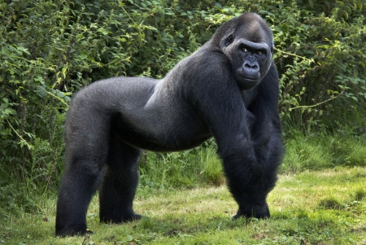
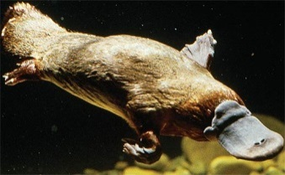
Why Are CG Dinucleotides More Rare than GC Dinucleotides in Genomic Sequences?
Different species have widely varying GC-content (percentages of G+C nucleotides in the genome).
Each of the dinucleotides CC, CG, GC, and GG is expected to occur in the human genome with frequency 0.23 * 0.23 = 5.29%.
46% for gorilla and human
58% for platypus
But the frequency of CG in the human genome is only 1%!

Slide 30
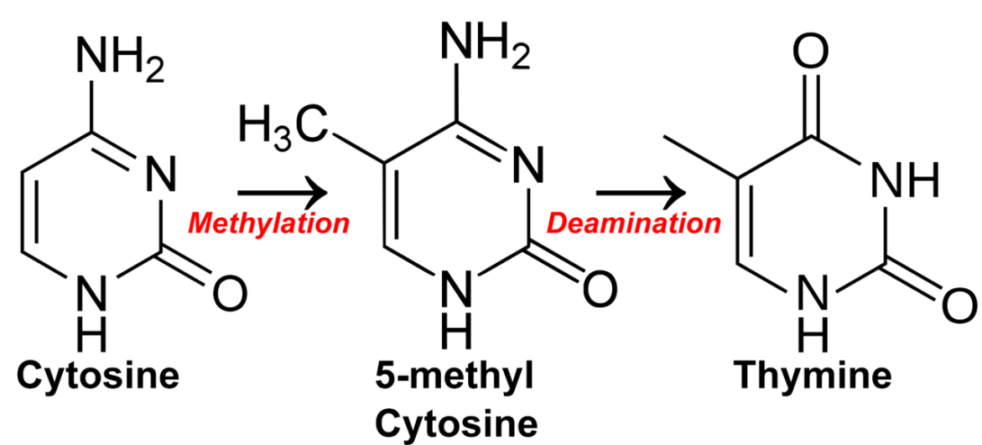
Methylation
Methylation: adds a methyl (CH₃) group to the cytosine nucleotide (often within a CG dinucleotide).
The resulting methylated cytosine has the tendency to deaminate into thymine.
As a result of methylation, CG is the least frequent dinucleotide in many genomes.

Slide 31
Looking for CG-islands
Methylation is often suppressed around genes in areas called CG-islands (CG appears frequently).
ATTTCTTCTCGTCGACGCTAATTTCTTGGAAATATCATTAT
STOP and Think: In a first attempt to find genes, how would you search for CG-islands?

Slide 32
Looking for CG-islands
0
Log-odds ratio
CG-island more likely
Non-CG island more likely
Different windows may classify the same position in the genome differently.
It is not clear how to choose the length of the window for detecting CG-islands.
Does it make sense to choose the same window length for all regions in the genome?

Slide 33


Slide 34
Why Have Biologists Still Not Developed an HIV Vaccine?
Classifying HIV Phenotypes
Gambling with Yakuza
From a Crooked Casino to a Hidden Markov Model
Decoding Problem
The Viterbi Algorithm
Profile HMMs for Sequence Alignment
Classifying proteins with profile HMMs
Viterbi Learning
Soft Decoding Problem
Baum-Welch Learning

Slide 35


Turning the Dealer into a Machine
Think of the dealer as a machine with k hidden states (F and B) that proceeds in a sequence of steps.
In each step, it emits a symbol (H or T) while being in one of its hidden states.
While in a certain state, the machine makes two decisions:
Which symbol will I emit?
Which hidden state will I move to next?
H
T
H
H
T

Slide 36
Why “Hidden”?
An observer can see the emitted symbols of an HMM but does not know which state the HMM is currently in.
The goal is to infer the most likely sequence of hidden states of an HMM based on the sequence of emitted symbols.

Slide 37
Hidden Markov Model (HMM)
Σ: an alphabet of emitted symbols
States : a set of hidden states
Transition = (transition_{l,k}): a |States| ×|States| matrix of transition probabilities (of changing from state l to state k)
Emission= (emission_{k}(b)): a |States| × |∑| matrix of emission probabilities (of emitting symbol b when the HMM is in state k)
H and T
F and B
F B
F 0.9 0.1
B 0.1 0.9
H T
F 0.50 0.50
B 0.75 0.25

Slide 38
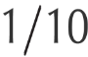
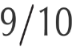
HMM Diagram
Transition
F B
F 0.9 0.1
B 0.1 0.9
F
B

Slide 39
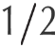
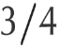
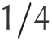
HMM Diagram
Transition
F B
F 0.9 0.1
B 0.1 0.9
F
B
Emission
H T
F 0.50 0.50
B 0.75 0.25

Slide 40
Hidden Path
Hidden path: the sequence π = π₁… π_{n} of states that the HMM passes through.
Pr(x, π): the probability that an HMM follows the hidden path π and emits the string x = x₁ x₂ . . . x_{n}.
x: T H T H H H T H T T H
π: F F F B B B B B F F F
∑ _{all possible emitted strings x} ∑ _{all possible hidden paths π} Pr(x, π) = 1
Pr(x|π): the conditional probability that an HMM emits the string x after following the hidden path π.
∑ _{all possible emitted strings x} Pr(x|π) = 1

Slide 41
Pr(x, π) = ???
Pr(x|π) * Pr(π)
Pr(x, π): the probability that an HMM follows the hidden path π and emits the string x.
Pr(x_{i}|π_{i}) – probability that x_{i} was emitted from the state π_{i} (equal to emission_{πi}(x_{i})).
Pr(π_{i-1}→π_{i}) – probability that the HMM moved from π_{i-1}→π_{i} (equal to transition_{πi,πi+1}).
x
π
Pr(π_{i-1}→π_{i})
Pr(x_{i}|π_{i})
T H T H H H T H T T H
F F F B B B B B F F F
.9 .9 .1 .9 .9 .9 .9 .1 .9 .9
½ ½ ½ ¾ ¾ ¾ ¼ ¾ ½ ½ ½
.5
.9
.9
.1
½
½
½
¾
Pr(π) = Π_{i=1,n} Pr(π_{i-1}→π_{i}) = Π_{i=1,n} transition_{πi-1,πi}
Pr(x|π) = Π_{i=1,n} Pr(x_{i}|π_{i}) = Π_{i=1,n} emission_{πi}(x_{i})

Slide 42
Computing Probability of a Hidden Path Pr(π) .
Probability of a Hidden Path Problem. Compute the probability of an HMM’s hidden path.
Input: A hidden path π in an HMM (∑,States,Transition,Emission).
Output: The probability of this path, Pr(π).

Slide 43
Computing Probability of a Hidden Path Pr(π) and Conditional Probability of an Outcome Pr(x|π)
Probability of a Hidden Path Problem. Compute the probability of an HMM’s hidden path.
Input: A hidden path π in an HMM (∑,States,Transition,Emission).
Output: The probability of this path, Pr(π).
Probability of an Outcome Given a Hidden Path Problem. Compute the probability that an HMM will emit a given string given its hidden path.
Input: A string x=x₁,…x_{n} emitted by an HMM (∑, States, Transition, Emission) and a hidden path π= π₁,…, π_{n}.
Output: The conditional probability Pr(x|π) that x will be emitted given that the HMM follows the hidden path π.

Slide 44
Why Have Biologists Still Not Developed an HIV Vaccine?
Classifying HIV Phenotypes
Gambling with Yakuza
From a Crooked Casino to a Hidden Markov Model
Decoding Problem
The Viterbi Algorithm
Profile HMMs for Sequence Alignment
Classifying proteins with profile HMMs
Viterbi Learning
Soft Decoding Problem
Baum-Welch Learning

Slide 45
Decoding Problem
Decoding Problem: Find an optimal hidden path in an HMM given its emitted string.
Input: A string x = x₁ . . . x_{n} emitted by an HMM (∑, States, Transition, Emission).
Output: A path π that maximizes the probability Pr(x,π) over all possible paths through this HMM.
Pr(x, π) = Pr(x|π) * Pr(π)
= Π _{i=1,n} Pr(x_{i}|π_{i}) * Pr(π_{i-1}→π_{i})
= Π _{i=1,n} emission_{πi} (x_{i}) * transition_{πi-1,πi}

Slide 46
Building Manhattan for the Crooked Casino
HMM diagram
x₁
x₂
x₃
x₄
x₅
x_{n}
B
B
B
B
B
B
F
F
F
F
F
F

Slide 47
Building Manhattan for the Crooked Casino
HMM diagram
source
B
B
B
B
B
B
sink
F
F
F
F
F
F

Slide 48
Building Manhattan for the Crooked Casino
HMM diagram
source
B
B
B
B
B
B
sink
F
F
F
F
F
F
F
B
B
B
F
F

Slide 49
Building Manhattan for Decoding Problem
HMM diagram

Slide 50
Building Manhattan for Decoding Problem
HMM diagram

Slide 51
Building Manhattan for Decoding Problem
HMM diagram

Slide 52
Alignment Manhattan vs. Decoding Manhattan
Alignment
three valid directions
Decoding
many valid directions

Slide 53
Edge Weights in the HMM Manhattan
k
l
i-1 i
Edge (l, k, i-1) from node (l, i-1) to node (k, i):
transitioning from state l to state k (with probability transition_{l,k})
emitting symbol x_{i} (with probability emission_{k}(x_{i})
weight(l, k, i-1)=emission_{k}(x_{i}) * transition_{l,k}

Slide 54
Edge Weights for the Crooked Casino
F B
F 0.9 0.1
B 0.1 0.9
emission
weight(l,k,i-1) =emission_{k}(x_{i}) * transition_{l,k}
H T
F 0.50 0.50
B 0.75 0.25
weight₁(B,B,1)=
emission_{B}(H) * transition_{B,B} =
0.75*0.9
transition
1/2
1
0.50*0.1
0.75*0.1
1
1/2
F
F
F
F
F
F
0.5*0.9
H H T T H H

Slide 55
Product Weight of a Hidden Path
Pr(x, π) = Π _{i=1,n} emission_{πi} (x_{i}) * transition_{πi-1,πi}
= Π _{i=1,n} weight of the i-th edge in path π
= Π _{i=1,n} weight(π_{i-1}, π_{i}, i-1)

Slide 56
Why Have Biologists Still Not Developed an HIV Vaccine?
Classifying HIV Phenotypes
Gambling with Yakuza
From a Crooked Casino to a Hidden Markov Model
Decoding Problem
The Viterbi Algorithm
Profile HMMs for Sequence Alignment
Classifying proteins with profile HMMs
Viterbi Learning
Soft Decoding Problem
Baum-Welch Learning

Slide 57
Dynamic Programming for Decoding Problem
k
i-1 i

Slide 58
Dynamic Programming for Decoding Problem
score_{k,i} : the maximum product weight among all paths from source to node (k, i):
k
i-1 i
score_{k,i} = max _{all states} _{l} {score_{l,i-1}· weight of edge from (l,i-1) to (k,i)}
= max _{all states} _{l} {score_{l,i-1} · weight(l,k, i-1)}

Slide 59
Recurrence for Viterbi Algorithm
Recurrence:
score_{k, i} = max _{all states} _{l} {score_{l,i-1} · weight(l,k,i-1)}
Initialization:
score_{source} = 1
The maximum product weight over all paths from source to sink:
score_{sink} = max _{all states} _{l} score_{l,n}

Slide 60
Running Time of the Viterbi Algorithm
Running time ~ #edges in the Viterbi graph ~ O(|States|² • n)

Slide 61
Running Time of the Viterbi Algorithm
Forbidden transition: an edge not represented in the HMM diagram.
Running time ~ #edges in the Viterbi graph ~ O(#edges in the HMM diagram•n)

Slide 62
From Product of Weights to Sum of Their Logarithms
Since score_{k,i} may become small (danger of underflow), biologists prefer to work with logarithms of scores:
score_{k, i} = max _{all states} _{l} { score_{l,i-1} · weight(l,k,i-1) }
log(score_{k, i}) = max _{all states} _{l} { log(score_{l,i-1})+log(weight(l,k,i-1) }
This transformation substitutes weights of edges by their logarithms:
product of weights → sum of weights

Slide 63
Computing Pr(π) Versus Computing Pr(x)
Pr(x, π): the probability that an HMM follows the hidden path π and emits the string x = x₁ x₂ . . . x_{n}.
x: T H T H H H T H T T H
π: F F F B B B B B F F F
.5 .9 .9 .1 .9 .9 .9 .9 .1 .9 .9
Pr(π) = ∑_{all possible emitted strings x} Pr(x, π)=Π_{i=1,n}transition_{πi-1,πi}
Pr(x) = ∑ _{all possible hidden paths π} Pr(x, π) =
Pr(x) = ∑ _{all possible hidden paths π} product weight of π
score_{sink}=max _{all possible hidden paths π} product weight of π

Slide 64
What is the Most Likely Outcome of an HMM?
Outcome Likelihood Problem. Find the probability that an HMM emits a given string.
Input: A string x = x₁ . . . x_{n} emitted by an HMM (∑, States, Transition, Emission).
Output: The probability Pr(x) that the HMM emits x.
STOP and Think: Can you solve the Outcome Likelihood Problem by making a single change in the Viterbi recurrence
score_{k, i} = max _{all states} _{l} {score_{l,i-1} · weight(l,k,i-1)} ?

Slide 65
Viterbi Algorithm: From MAX to ∑
forward_{k,i} : total product weight of all paths to (k,i):
forward_{k,i} = ∑ _{all states} _{l} {forward_{l,i-1} · weight of (l,i-1)→(k,i)}
= ∑ _{all states} _{l} {forward_{l,i-1} · weight(l, k, i-1)}
k
i-1 i

Slide 66
Viterbi Algorithm: From MAX to ∑
forward_{k,i} : total product weight of all paths to (k,i):
score_{k,i} = max _{all states} _{l} { score_{l,i-1} · weight(l, k, i-1)}
k
i-1 i

Slide 67
Would the Frequent Words algorithm find this hidden message?

Slide 68
Why Have Biologists Still Not Developed an HIV Vaccine?
Classifying HIV Phenotypes
Gambling with Yakuza
From a Crooked Casino to a Hidden Markov Model
Decoding Problem
The Viterbi Algorithm
Profile HMMs for Sequence Alignment
Classifying proteins with profile HMMs
Viterbi Learning
Soft Decoding Problem
Baum-Welch Learning

Slide 69
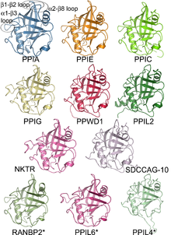
Classifying Proteins into Families
Proteins are organized into protein families represented by multiple alignments.
A distant cousin may have weak pairwise similarities with family members failing a significance test.
However, it may have weak similarities with many family members, indicating a relationship.

Slide 70
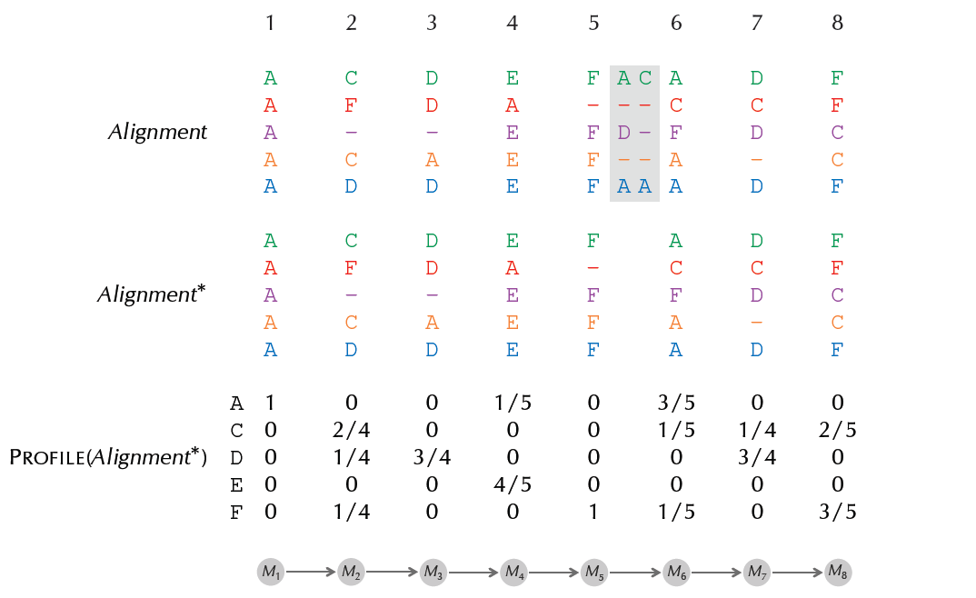
From Alignment to Profile
Remove columns if the fraction of space symbols (“-”) exceeds θ, the maximum fraction of insertions threshold.

Slide 71
From Alignment to Profile

Slide 72
From Alignment to Profile

Slide 73
From Profile to HMM
HMM diagram
A D D A F F D F
1 * .25 * .75 * .20 * 1 * .20 * .75 * .60

Slide 74
Toward a Profile HMM
M₁
M₂
M₃
M₄
M₅
M₆
M₇
M₈
A D D A F F D F
F
STOP and Think: How do we model insertions?
Notes:
simple_profile_HMM

Slide 75
Toward a Profile HMM: Insertions
I₁
M₁
M₂
M₃
M₄
M₅
M₆
M₇
M₈
A D D A F F D F
F
Notes:
profile_HMM_match_insertion

Slide 76
Toward a Profile HMM: Insertions
I₀
I₁
I₂
I₃
I₄
I₅
I₆
I₇
I₈
M₁
M₂
M₃
M₄
M₅
M₆
M₇
M₈
A D D A F F D F
F
Notes:
profile_HMM_match_insertion

Slide 77
Toward a Profile HMM: Insertions
I₀
I₁
I₂
I₃
I₄
I₅
I₆
I₇
I₈
M₁
M₂
M₃
M₄
M₅
M₆
M₇
M₈
A D D A F F D F
F
Notes:
profile_HMM_match_insertion

Slide 78
Toward a Profile HMM: Insertions
I₀
I₁
I₂
I₃
I₄
I₅
I₆
I₇
I₈
M₁
M₂
M₃
M₄
M₅
M₆
M₇
M₈
A D D A F F D F
F
Notes:
profile_HMM_match_insertion

Slide 79
Toward a Profile HMM: Insertions
I₀
I₁
I₂
I₃
I₄
I₅
I₆
I₇
I₈
M₁
M₂
M₃
M₄
M₅
M₆
M₇
M₈
A D D A F F D F
F
STOP and Think: How do we model deletions?
Notes:
profile_HMM_match_insertion

Slide 80
Toward a Profile HMM: Deletions
I₀
I₁
I₂
I₃
I₄
I₅
I₆
I₇
I₈
M₁
M₂
M₃
M₄
M₅
M₆
M₇
M₈
A A F F D F
Notes:
profile_HMM_skipping_states

Slide 81
Toward a Profile HMM: Deletions
I₀
I₁
I₂
I₃
I₄
I₅
I₆
I₇
I₈
M₁
M₂
M₃
M₄
M₅
M₆
M₇
M₈
A A F F D F
Notes:
profile_HMM_skipping_states

Slide 82
Toward a Profile HMM: Deletions
I₀
I₁
I₂
I₃
I₄
I₅
I₆
I₇
I₈
M₁
M₂
M₃
M₄
M₅
M₆
M₇
M₈
A A F F D F
STOP and Think: How many edges are in this HMM diagram?
Notes:
profile_HMM_skipping_states

Slide 83
Adding “Deletion States”
D₂
D₃
I₀
I₁
I₂
I₃
I₄
I₅
I₆
I₇
I₈
M₁
M₂
M₃
M₄
M₅
M₆
M₇
M₈
A A F F D F
Notes:
profile_HMM_introducing_deletion_states

Slide 84
Adding “Deletion States”
D₁
D₂
D₃
D₄
D₅
D₆
D₇
D₈
I₀
I₁
I₂
I₃
I₄
I₅
I₆
I₇
I₈
M₁
M₂
M₃
M₄
M₅
M₆
M₇
M₈
A A F F D F
Notes:
profile_HMM_introducing_deletion_states

Slide 85
Adding “Deletion States”
D₁
D₂
D₃
D₄
D₅
D₆
D₇
D₈
I₀
I₁
I₂
I₃
I₄
I₅
I₆
I₇
I₈
M₁
M₂
M₃
M₄
M₅
M₆
M₇
M₈
A A F F D F
STOP and Think: Are any edges still missing in this HMM diagram?
Notes:
profile_HMM_introducing_deletion_states

Slide 86
Adding Edges Between Deletion/Insertion States
D₁
D₂
D₃
D₄
D₅
D₆
D₇
D₈
I₀
I₁
I₂
I₃
I₄
I₅
I₆
I₇
I₈
M₁
M₂
M₃
M₄
M₅
M₆
M₇
M₈
Notes:
profile_HMM_complete

Slide 87
The Profile HMM is Ready to Use!
S
t
a
r
t
E
n
d
D₁
D₂
D₃
D₄
D₅
D₆
D₇
D₈
S
I₀
I₁
I₂
I₃
I₄
I₅
I₆
I₇
I₈
E
M₁
M₂
M₃
M₄
M₅
M₆
M₇
M₈
Profile HMM Problem: Construct a profile HMM from a multiple alignment.
Input: A multiple alignment Alignment and a threshold θ (maximum fraction of insertions per column).
Output: Transition and emission matrices of the profile HMM HMM(Alignment,θ).
But what are Transition and Emission matrices?
Notes:
profile_HMM_complete

Slide 88
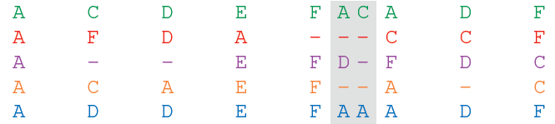
Hidden Paths Through Profile HMM
Note: this is a hidden path in an HMM diagram (not in a Viterbi graph).

Slide 89
Transition Probabilities of Profile HMM
4 transitions from M₅ :
1 + 1 + 1 = 3 into I₅
1 into M₆
0 into D₆
transition_{Match(5),Insertion(5)} = 3/4
transition_{Match(5),Match(6)} = 1/4
transition_{Match(5),Deletion(6)} = 0

Slide 90
Emission Probabilities of Profile HMM
symbols emitted from M₂:
C, F, C, D
emission_{Match(2)}(A) = 0
emission_{Match(2)}(C) = 2/4
emission_{Match(2)}(D) = 1/4
emission_{Match(2)}(E) = 0
emission_{Match(2)}(F) = 1/4

Slide 91
Forbidden Transitions
Gray cells: edges in the HMM diagram.
Clear cells: forbidden transitions.
Don’t forget pseudocounts:
HMM(Alignment,θ,σ)

Slide 92
Why Have Biologists Still Not Developed an HIV Vaccine?
Classifying HIV Phenotypes
Gambling with Yakuza
From a Crooked Casino to a Hidden Markov Model
Decoding Problem
The Viterbi Algorithm
Profile HMMs for Sequence Alignment
Classifying proteins with profile HMMs
Viterbi Learning
Soft Decoding Problem
Baum-Welch Learning

Slide 93
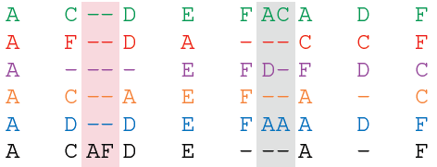
Aligning a Protein Against a Profile HMM
Alignment
Protein
ACAFDEAF

Slide 94
Aligning a Protein Against a Profile HMM
Alignment
Protein
ACAFDEAF
Apply Viterbi algorithm to find optimal hidden path!

Slide 95
Aligning a Protein Against a Profile HMM
Alignment
Protein
ACAFDEAF
Apply Viterbi algorithm to find optimal hidden path!

Slide 96
Profile HMM diagram

Slide 97
Profile HMM diagram
STOP and Think: How many rows and columns does the Viterbi graph of this profile HMM have?

Slide 98
Profile HMM diagram
Viterbi graph of profile HMM:
#columns=
#visited states

Slide 99
Profile HMM diagram
Viterbi graph of profile HMM:
#columns=
#visited states
STOP and Think: What is wrong with this Viterbi graph?

Slide 100
Profile HMM diagram
Viterbi graph of profile HMM:
#columns=
#visited states
By definition,
#columns =
#emitted symbols

Slide 101
Profile HMM diagram
Nearly correct Viterbi graph of profile HMM:
Vertical edges enter “silent” deletion states

Slide 102
Profile HMM diagram
Correct Viterbi graph of profile HMM:
Adding 0-th column that contains only silent states

Slide 103
Alignment with a Profile HMM
Sequence Alignment with Profile HMM Problem: Align a new sequence to a family of aligned sequences using a profile HMM.
Input: A multiple alignment Alignment, a string Text, a threshold θ (maximum fraction of insertions per column), and a pseudocount σ.
Output: An optimal hidden path emitting Text in the profile HMM HMM(Alignment, θ, σ).

Slide 104
Have I Wasted Your Time?

Slide 105
Have I Wasted Your Time?
s_{I(j-1),i-1} * weight(I(j-1),M(j),i-1)
s_{D(j-1),i-1} * weight(D(j-1), M(j),i-1)
s_{M(j-1),i-1} * weight(M(j-1), M(j),i-1)
s_{M(j),i} = max
s_{i-1, j} + score(v_{i}, -)
s_{i, j-1} + score(-,w_{j})
s_{i-1, j-1}+ score(v_{i},w_{j})
s_{i, j} = max
The choice of alignment path is now based on varying transition and emission probabilities!

Slide 106

I Have Not Wasted Your Time!
s_{I(j-1),i-1} * weight_{i-1}(I(j-1),M(j))
s_{D(j-1),i-1} * weight_{i-1}(D(j-1), M(j))
s_{M(j-1),i-1}* weight_{i-1}(M(j-1), M(j))
s_{M(j),i} = max
Individual scoring parameters for each edge in the alignment graph capture subtle similarities that evade traditional alignments.

Slide 107
Why Have Biologists Still Not Developed an HIV Vaccine?
Classifying HIV Phenotypes
Gambling with Yakuza
From a Crooked Casino to a Hidden Markov Model
Decoding Problem
The Viterbi Algorithm
Profile HMMs for Sequence Alignment
Classifying proteins with profile HMMs
Viterbi Learning
Soft Decoding Problem
Baum-Welch Learning

Slide 108
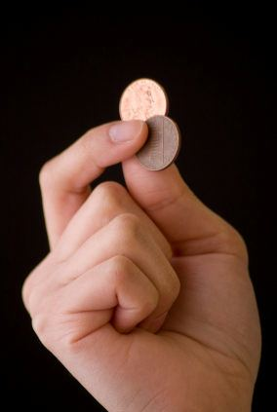
HMM Parameter Estimation
Thus far, we have assumed that the transition and emission probabilities are known.
Imagine that you only know that the crooked dealer is using two coins and observe:
HHTHHHTHHHTTTTHTTTTH
What are the biases of the coins and how often the dealer switches coins?
Can we develop an algorithm for parameter estimation for an arbitrary HMM?

Slide 109
If Dealer Reveals the Hidden Path...
HMM Parameter Estimation Problem: Find optimal parameters explaining the emitted string and the hidden path.
Input: A string x = x₁ . . . x_{n} emitted by a k-state HMM with unknown transition and emission probabilities following a known hidden path π = π₁ . . . π_{n}.
Output: Transition and Emission matrices that maximize Pr(x, π) over all possible matrices of transition and emission probabilities.
HHTHHHTHHHTTTTHTTTTH
BFFBFFFBBFFBFFBBBBFF

Slide 110
If the Hidden Path is Known...
T_{l,k}: #transitions from state l to state k in path π.
transition_{l,k}= #transitions from state l to state k / # all transitions from l
= T_{l,k} / #visits to state l
HHTHHHTHHHTTTTHTTTTH
BFFBFFFBBFFBFFBBBBFF
T_{B,F} = 5
/9

Slide 111
If the Hidden Path is Known...
T_{l,k}: # transitions from state l to state k in path π.
E_{k}(b): # times symbol b is emitted when path π is in state k.
transition_{l,k}= #transitions from state l to state k / # all transitions from l
= T_{l,k} / #visits to state l
emission_{k}(b) =
#times symbol b is emitted in state k / # all symbols emitted in state k
= E_{k}(b) / #visits to state l
HHTHHHTHHHTTTTHTTTH
E_{F}(T)=6
/11
⬆
⬆
⬆
⬆
⬆
⬆
BFFBFFFBBFFBFFBBBFF
T_{B,F} = 5

Slide 112
From emitted string to hidden path&Parameters
(emitted string, ???, Parameters) → hidden path
Viterbi algorithm for Decoding Problem
(emitted string, hidden path, ???) → Parameters
algorithm for HMM Parameter Estimation Problem
(emitted string, ???, ??? ) → hidden path & Parameters

Slide 113
When BOTH HiddenPath and Parameters Are Unknown
HMM Parameter Learning Problem. Estimate the parameters of an HMM explaining an emitted string.
Input: A string x = x₁ . . . x_{n} emitted by a k-state HMM with unknown transition and emission probabilities.
Output: Matrices Transition and Emission that maximize Pr(x, π) over all possible transition and emission matrices and over all hidden paths π.

Slide 114
Reconstructing HiddenPath AND Parameters
emitted string
hidden path
Parameters

Slide 115
Reconstructing HiddenPath AND Parameters
emitted string
Start from arbitrary choice of Parameters
Decoding Problem
hidden path
Parameters

Slide 116
Reconstructing HiddenPath AND Parameters
emitted string
hidden path
Parameters

Slide 117
Reconstructing HiddenPath AND Parameters
emitted string
HMM Parameter Estimation Problem
hidden path
Parameters

Slide 118
Reconstructing HiddenPath AND Parameters
emitted string
hidden path
Parameters’

Slide 119
Viterbi Learning
emitted string
Iterate!
hidden path
Parameters’

Slide 120
Changing the Question
The Viterbi algorithm gives a “yes” or “no” answer to the question: ”Was the HMM in state k at time i given that it emitted string x?”
STOP and Think: This question fails to account for how certain we are in the “yes”/“no” answer. How can we change this hard question into a soft one?

Slide 121
Why Have Biologists Still Not Developed an HIV Vaccine?
Classifying HIV Phenotypes
Gambling with Yakuza
From a Crooked Casino to a Hidden Markov Model
Decoding Problem
The Viterbi Algorithm
Profile HMMs for Sequence Alignment
Classifying proteins with profile HMMs
Viterbi Learning
Soft Decoding Problem
Baum-Welch Learning

Slide 122
Changing the Question
The Viterbi algorithm gives a “yes” or “no” answer to the question: ”Was the HMM in state k at time i given that it emitted string x?”
STOP and Think: This question fails to account for how certain we are in the “yes”/“no” answer. How can we change this hard question into a soft one?

Slide 123
What Is Pr(π_{i}=k, x)?
Pr(π_{i}=k, x): the unconditional probability Pr(π_{i}=k, x) that a hidden path will pass through state k at time i and emit x.
STOP and Think: What is the probability that the dealer was using the Fair coin at the 5th flip given that he generated a sequence of flips HHTHTHHHTT?

Slide 124
Pr(π_{i}=k, x): Total Product Weight of All Paths Through
k
Pr(π_{i}=k, x): the unconditional probability that a hidden path will pass through state k at time i and emit x.
Pr(π_{i}=k, x) = ∑ _{all paths π with πi =k} Pr(x, π)
k
i
∑ _{all possible states} _{k, all possible paths x} Pr(π_{i}=k, x) = 1

Slide 125
What Is Pr(π_{i} =k|x)?
Pr(π_{i} =k|x): the conditional probability that the HMM was in state k at time i given that it emitted string x.
STOP and Think: What is the probability that the dealer was using the Fair coin at the 5th flip given that he generated a sequence of flips HHTHTHHHTT?

Slide 126
What Is Pr(π_{i} =k|x)?
Pr(π_{i} =k|x): the conditional probability that the HMM was in state k at time i given that it emitted string x.
STOP and Think: What is the probability that the dealer was using the Fair coin at the 5th flip given that he generated a sequence of flips HHTHTHHHTT?
Compare with:
Pr(π_{i}=k, x): the unconditional probability that a hidden path will pass through state k at time i and emit x.
STOP and Think: What is the probability that the dealer will generate a sequence of flips HHTHTHHHTT?
while using the Fair coin at the 5th flip?

Slide 127
What Is Pr(π_{i} =k|x)?
Pr(π_{i} =k|x): the conditional probability that the HMM was in state k at time i given that it emitted string x.
k
i
Pr(π_{i} =k|x): the fraction of the product weight of paths visiting over the weight of all paths:
k
Pr(π_{i} =k|x) = Pr(π_{i}=k, x) / Pr(x)
= ∑ _{all paths π with πi =k} Pr(x, π) / ∑ _{all paths π} Pr(x, π)

Slide 128
Soft Decoding Problem
Soft Decoding Problem: Find the probability that an HMM was in a particular state at a particular moment, given its output.
Input: A string x = x₁ . . . x_{n} emitted by an HMM (∑, States, Transition, Emission).
Output: The conditional probability Pr(π_{i} =k|x) that the HMM was in state k at step i, given x.

Slide 129
Computing Pr(π_{i}=k, x)
Pr(π_{i}=k, x) = total product weights of all paths through the Viterbi graph for x that pass through the node (k, i).
Each such path is formed by a blue subpath ending in the node and a red subpath starting in the node
k
k
Viterbi graph with all edges reversed
k
Pr(π_{i}=k, x) =
i
∑ product weights of all blue paths * ∑ product weights of all red paths
forward_{k,i}
*
???

Slide 130
Computing Pr(π_{i}=k, x)
Pr(π_{i}=k, x) = total product weights of all paths through the Viterbi graph for x that pass through the node (k, i).
Each such path is formed by a blue subpath ending in the node and a red subpath starting in the node
k
k
Viterbi graph with all edges reversed
k
Pr(π_{i}=k, x) =
i
∑ product weights of all blue paths * ∑ product weights of all red paths
forward_{k,i}
*
backward_{k,i}

Slide 131
Forward-Backward Algorithm
Since the reverse edge connecting node (l, i+1) to node (k, i) in the reversed graph has weight weight(k, l, i):
backward_{k,i} = ∑ _{all states l} backward_{l,i+1} · weight(k, l, i)
Combining the forward-backward algorithm with the solution to the Outcome Likelihood Problem yields
k
l
i i+1
Forward_{k,i} * backward_{k,i}
Pr(π_{i} =k|x) = Pr(π_{i}=k, x)/Pr(x) =
forward(sink)

Slide 132
The Conditional Probability Pr(π_{i}=l, π_{i+1}=k|x) that the HMM Passes Through an Edge in the Viterbi Graph
l
k
i i+1
∑ weights of blue paths * weight of black edge * ∑ weights of red paths
forward_{l,i} * weight(l, k, i) * backward_{k,i+1}
Pr(π_{i}=l, π_{i+1}=k|x) =
forward(sink)

Slide 133
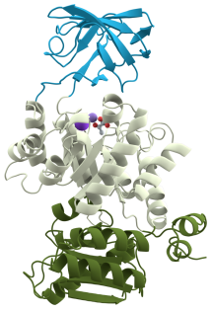
Why Have Biologists Still Not Developed an HIV Vaccine?
Classifying HIV Phenotypes
Gambling with Yakuza
From a Crooked Casino to a Hidden Markov Model
Decoding Problem
The Viterbi Algorithm
Profile HMMs for Sequence Alignment
Classifying proteins with profile HMMs
Viterbi Learning
Soft Decoding Problem
Baum-Welch Learning

Slide 134
Node Responsibility Matrix
Node responsibility matrix Π* = (Π*_{k,i}):
Π*_{k,i} = Pr(π_{i}=k|x)
k
Node responsibility matrix for the crooked casino

Slide 135
Edge Responsibility Matrix
Edge responsibility matrix
Π**_{l,k,i} = Pr(π_{i} = l, π_{i+1}=k|x)
l
k
Edge responsibility matrix for the crooked casino
Every element of Π* (Π**) corresponds to a node (edge) in the Viterbi graph. Define
Π = (Π*, Π**)

Slide 136
Baum-Welch Learning
Baum-Welch learning alternates between two steps:
Re-estimating the responsibility profile Π given the current HMM parameters (the E-step):
Re-estimating the HMM parameters given the current responsibility profile (the M-step):
(emitted string, ?, Parameters) → Π
(emitted string, Π, ?) → Parameters

Slide 137
Using a Responsibility Matrix to Compute Parameters
We have defined a transformation
(x, π, ?) → Parameters
that uses estimators T_{l,k} and E_{k}(b) based on a path π.
We now want to define a transformation:
(x, Π, ?) → Parameters
but the path is unknown.
Idea: Use expected values T_{l,k} and E_{k}(b) over all possible paths.

Slide 138
Redefining Estimators for Parameters (for a known path π)
T_{l,k}: #transitions from state l to state k in path π
T_{l,k} = ∑ _{i=1,n-1} T^{i}_{l,k}
1 if π_{i} = l and π_{i+1} = k 0 otherwise
T^{i}_{l,k}={
Rewriting
estimators:
HHTHHHTHHHTTTTHTTTTH
BFFBFFFBBFFBFFBBBBFF
T_{B, F} = 5
T^{i}_{B,F} = 10010000100100000100

Slide 139
Redefining Estimators for Parameters (for a known path π)
T_{l,k}: #transitions from state l to state k in path π
E_{k}(b): #times b is emitted when the path π is in state k
We now define
T_{l,k} = ∑ _{i=1,n-1} T^{i}_{l,}
1 if π_{i} = l and π_{i+1} = k
0 otherwise
1 if π_{i} = k and x_{i} = b
0 otherwise
T^{i}_{l,k}={
E^{i}_{k}(b)={
How would you redefine these estimators if π is unknown?
Rewriting
estimators:
E_{k}(b) = ∑ _{i=1,n} E^{i}_{k}(b)
E^{i}_{F}(T) = 00100010001011000010
HHTHHHTHHHTTTTHTTTTH
E_{F}(T)=6
⬆
⬆
⬆
⬆
⬆
⬆
BFFBFFFBBFFBFFBBBBFF
T_{B, F} = 5
T^{i}_{B,F} = 10010000100100000100

Slide 140
Redefining the Estimators T^{i}_{l,k} and E^{i}_{k}(b) When the Path is Unknown
T_{l,k}: #transitions from state l to state k in path π
E_{k}(b): #times b is emitted when the path π is in state k
We now define
1 if π_{i} = l and π_{i+1} = k 1 if π_{i} = k and x_{i} = b
0 otherwise 0 otherwise
T^{i}_{l,k}={
E^{i}_{k}(b)={
Pr(π_{i} =k|x) if x_{i} = b
0 otherwise
T^{i}_{l,k}=Pr(π_{i} =l, π_{i+1} =k|x) E^{i}_{k}(b)={
Π*_{k,i} if x_{i} = b
0 otherwise
T^{i}_{l,k} = Π**_{l,k,i} E^{i}_{k}(b)={

Slide 141
Baum-Welch Learning
Baum-Welch learning alternates between two steps:
Re-estimating the responsibility profile Π given the current HMM parameters (the E-step):
Re-estimating the HMM parameters given the current responsibility profile (the M-step):
(emitted string, ?, Parameters) → Π
(emitted string, Π, ?) → Parameters

Slide 142
Stopping Rules for the Baum-Welch Learning
Compute the probability that the HMM emits the string x under current Parameters:
Pr(emitted string|Parameters)
Compare with the probability for previous values of Parameters and stop if the difference is small.
Stop after a certain number of iterations.

Slide 143
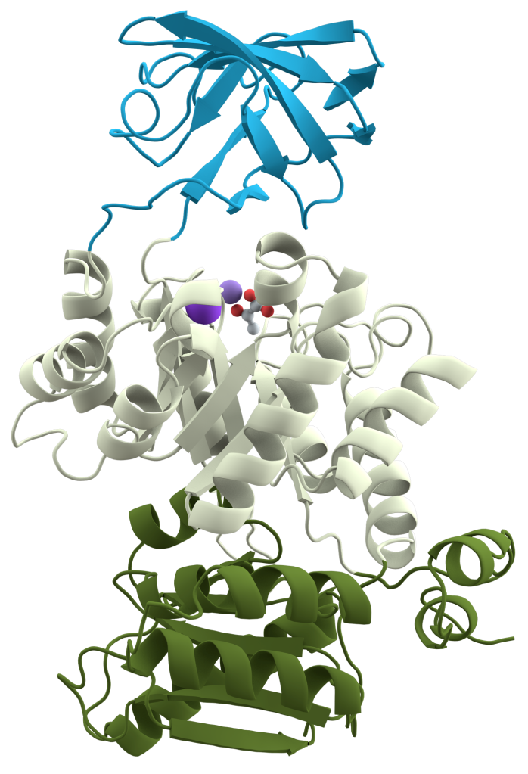
Nature is a Tinkerer and Not an Inventor
Protein domain: a conserved part of a protein that often can function independently.
Nature uses domains as building blocks, shuffling them to create multi-domain proteins.
Goal: classify domains into families even though sequence similarities between domains from the same family can be low.
A multi-domain protein

Slide 144
Searching for Protein Domains with Profile HMMs
Use alignments to break proteins into domains.
ABCDEFGHKLMNP
ERGHKLNPABTD
KLSNPACDEFTH

Slide 145
Searching for Protein Domains with Profile HMMs
Use alignments to break proteins into domains.
ABCDEFGHKLMNP
ERGHKLNPABTD
KLSNPACDEFTH

Slide 146
Searching for Protein Domains with Profile HMMs
Use alignments to break proteins into domains.
Construct alignment of domains from a given family (starting from highly similar domains whose attribution to a family is non-controversial).
ABCDEFGHKLMNP
ERGHKLNPABTD
KLSNPACDEFTH
ABCD
ABTD
AC-D
KLMNP
KL-NP
KLSNP
EFGH
ERGH
EFTH

Slide 147
Searching for Protein Domains with Profile HMMs
Use alignments to break proteins into domains.
Construct alignment of domains from a given family (starting from highly similar domains whose attribution to a family is non-controversial).
For each family, construct a profile HMM and estimate its parameters.
ABCDEFGHKLMNP
ERGHKLNPABTD
KLSNPACDEFTH
ABCD
ABTD
AC-D
KLMNP
KL-NP
KLSNP
EFGH
ERGH
EFTH

Slide 148
Searching for Protein Domains with Profile HMMs
Use alignments to break proteins into domains.
Construct alignment of domains from a given family (starting from highly similar domains whose attribution to a family is non-controversial).
For each family, construct a profile HMM and estimate its parameters.
Align the new sequence against each such HMM to find the best fitting HMM.
ABCDEFGHKLMNP
ERGHKLNPABTD
KLSNPACDEFTH
ABCD
ABTD
AC-D
KLMNP
KL-NP
KLSNP
EFGH
ERGH
EFTH

Slide 149
Pfam: Profile HMM Database
Each domain family in Pfam has:
Seed alignment: Initial multiple alignment of domains in this family.
HMM: Built from seed alignment for new searches.
Full alignment: Enlarged multiple alignment generated by aligning new domains against the seed HMM.
Final Challenge: Using the Pfam HMM for gp120 (constructed from a seed alignment of just 24 gp120 HIV proteins), construct alignments of all known gp120 proteins and identify the “most diverged” gp120 sequence.

